Slide 1

Chapter 2 Backtracking
Divesh Aggarwal
School of Computing
Department of Computer Science
Notes:
Talk about importance of accurate emotion expression and recognition for functioning in daily life.

Slide 2
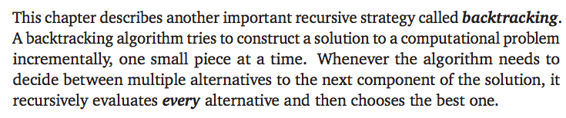
Backtracking
Don’t try to be smart! Backtracking algorithms are just brute-force algorithms designed properly.
Smarter algorithms will come soon (but not today) ☺

Slide 3
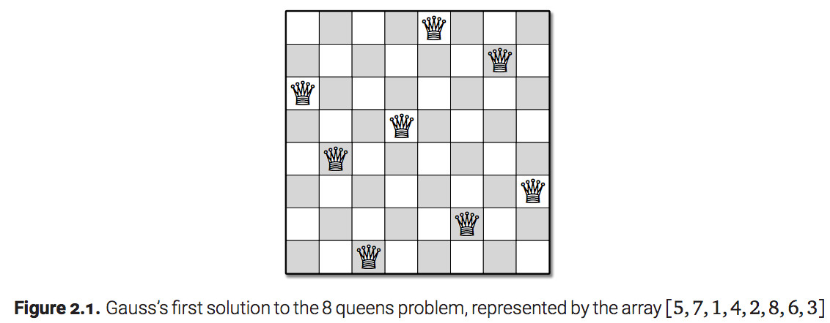
Example: N queens problem

Slide 4
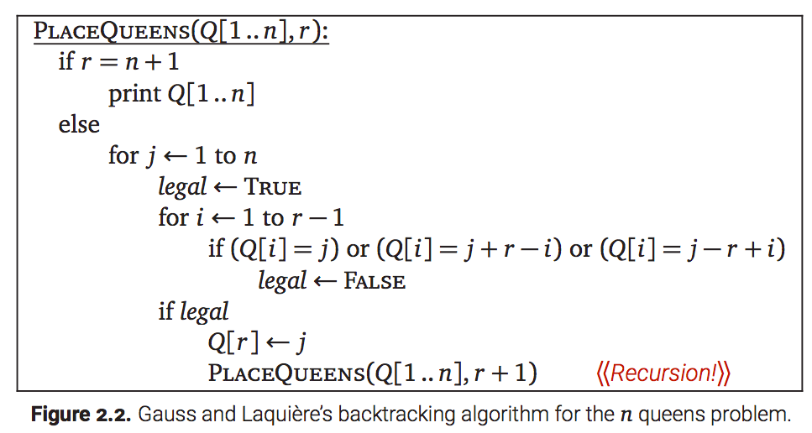
Backtracking Algorithm

Slide 5
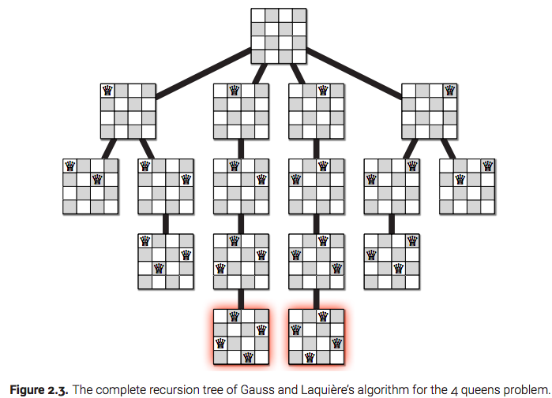
Backtracking = Depth First Search on Recursion Tree

Slide 6
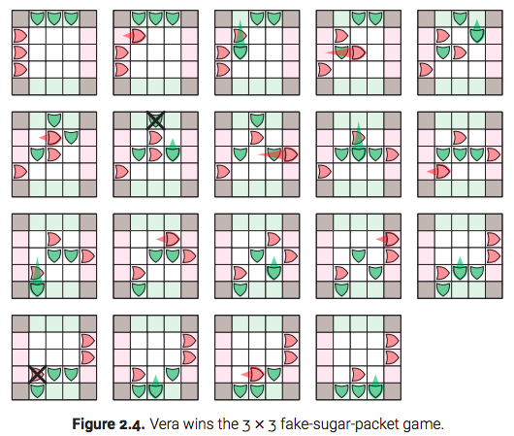
Game Trees
Horace and Vera play a two player game

Slide 7
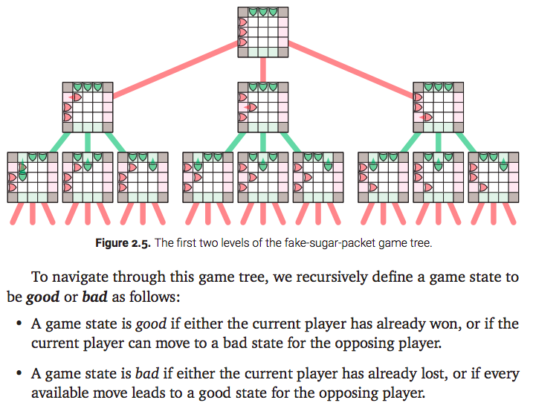
Play it Perfectly – A Backtracking Algorithm

Slide 8
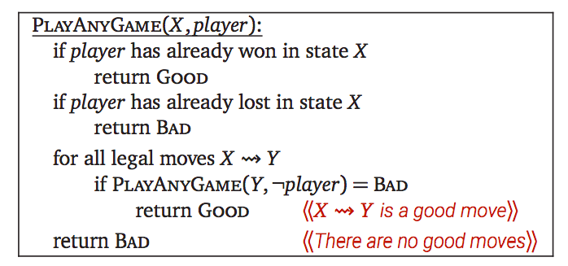
The Algorithm
All game-playing programs are based on this backtracking strategy
It might not be possible to traverse the entire game tree in practice
Sometimes game-playing programs employ heuristics to prune the tree by ignoring states obviously good or bad
For this module, we won’t be relying on heuristics at all even though they are sometimes useful in practice

Slide 9
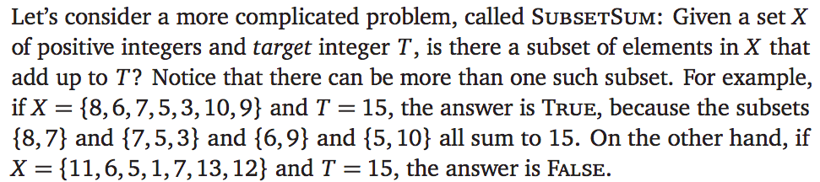
Subset sum

Slide 10
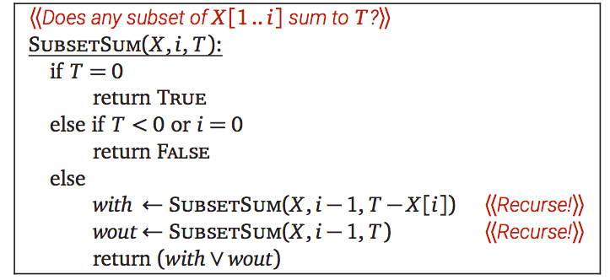
Backtracking Algorithm
CORRECTNESS: Immediate by Induction
ANALYSIS: T(n) = 2 T(n-1) + 1, which solves to T(n) = 2^{n} - 1

Slide 11
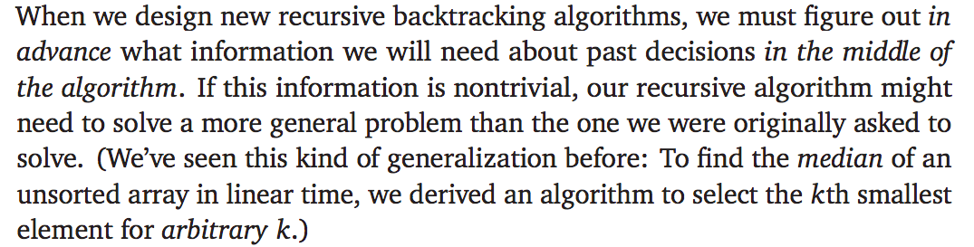
Backtracking Algorithms – General guideline

Slide 12
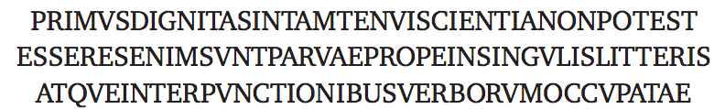
Text Segmentation Problem
Suppose you are given a string of letters representing text in some foreign language, but without any spaces or punctuation, and you want to break this string into its individual constituent words. For example
A fluent Latin reader would parse this string (in modern orthography) as Primus dignitas in tam tenui scientia non potest esse; res enim sunt parvae, prope in singulis litteris atque interpunctionibus verborum occupatae.
Some strings might have more than one valid splittings – we consider the simple problem where we need to find whether there exists a splitting

Slide 13
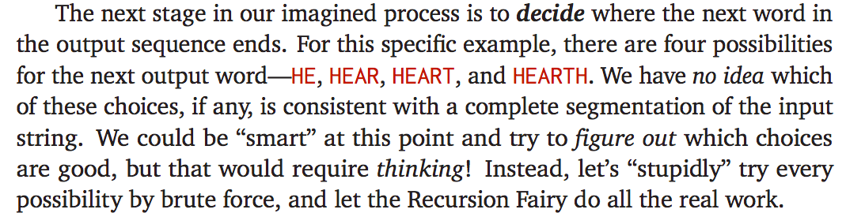
Text Segmentation Problem: An example
Jumping into the middle of the segmentation process, we might imagine the following picture:

Slide 14
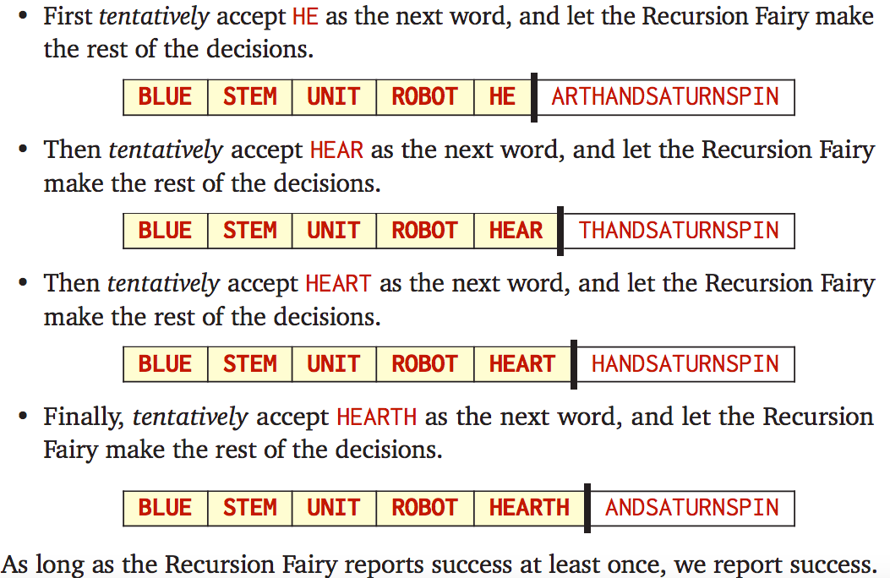
Text Segmentation Problem: An example

Slide 15
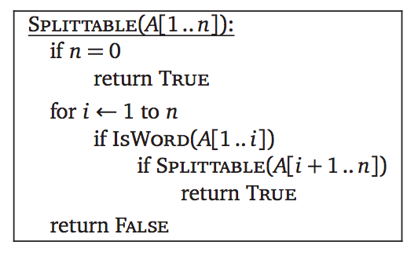
Text Segmentation: Backtracking Algorithm
We arrive at the following simple backtracking algorithm
REMARK: In practice, passing arrays as input parameters is rather slow; we should really find a more compact way to describe our recursive subproblems.

Slide 16
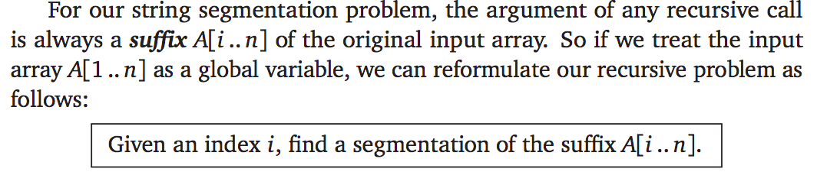
Having arrays as Global Variables

Slide 17
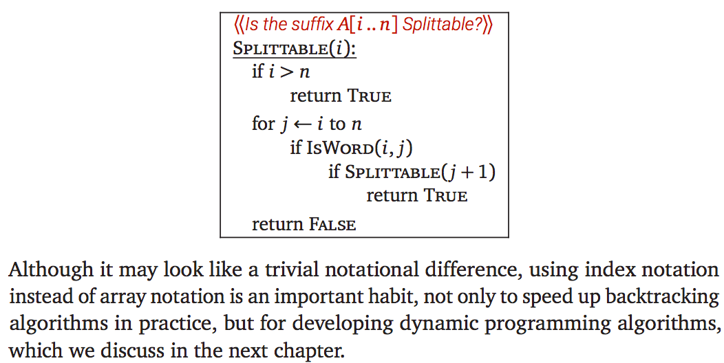
Modified Algorithm

Slide 18
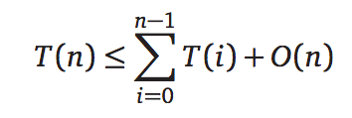
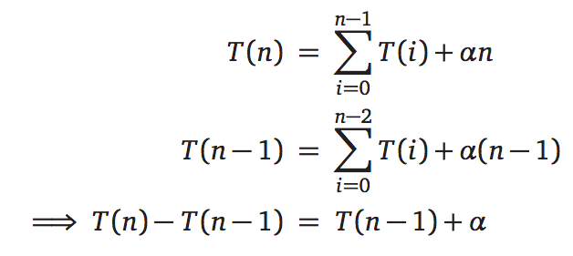


Analysis
This analysis is tight in the worst case! Why?

Slide 19
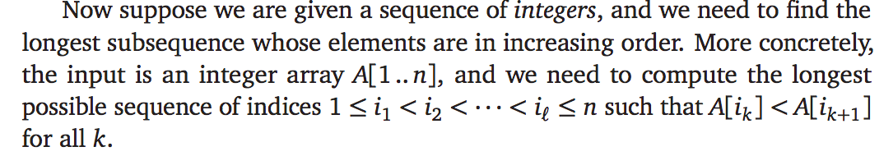
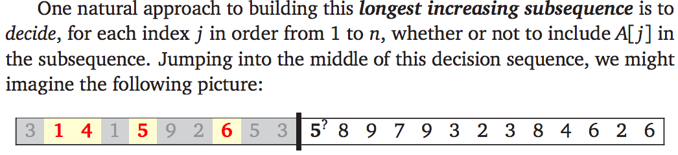
Example: Longest Increasing Subsequence

Slide 20
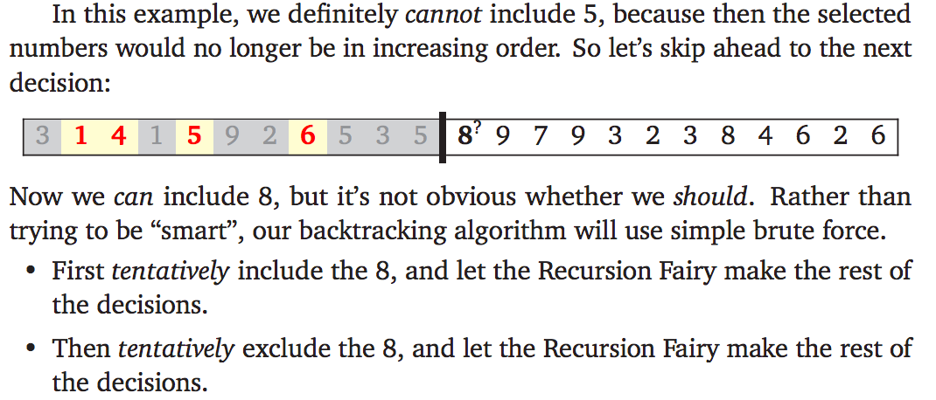
Example: Longest Increasing Subsequence

Slide 21
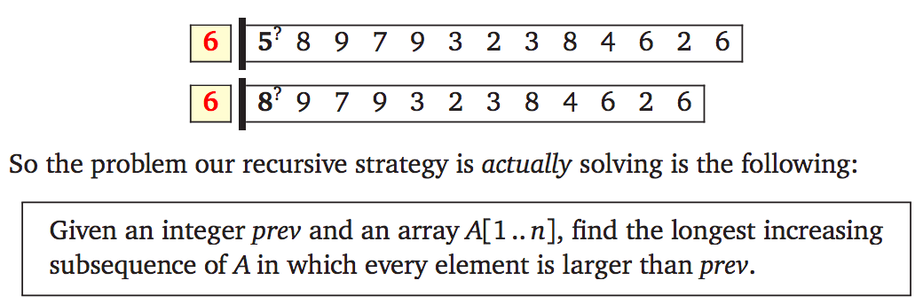
Strategy for the algorithm
For the obvious backtracking algorithm, the only information we need about the past is the last number selected so far. We can now revise our pictures by erasing everything we don’t need:

Slide 22
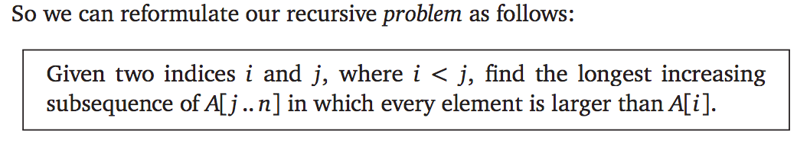
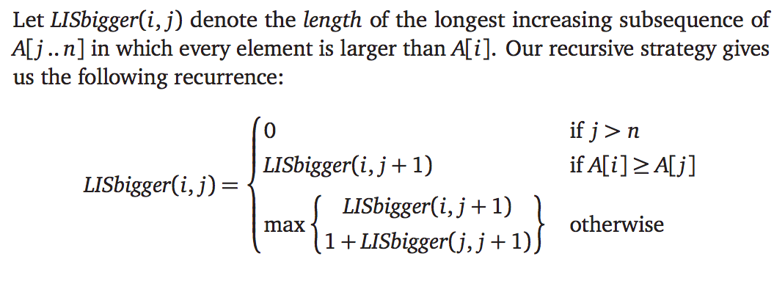
But we don’t want arrays as input…

Slide 23
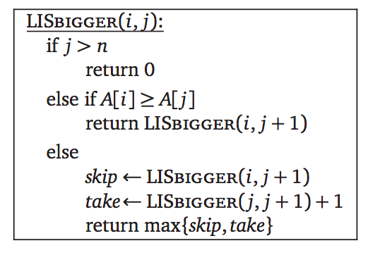
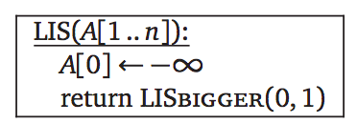
The algorithm
Finally, we need to connect our recursive strategy to the original problem: Finding the longest increasing subsequence of an array with no other constraints.
Running time: T(n) = 2T(n-1) + 1, which as usual implies that T(n) = O(2^{n}).

Slide 24
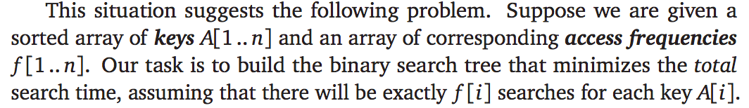
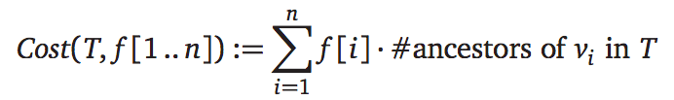
Example: Optimal Binary Search Trees
A balanced binary search tree might not always be optimal if some items are significantly more popular than others

Slide 25
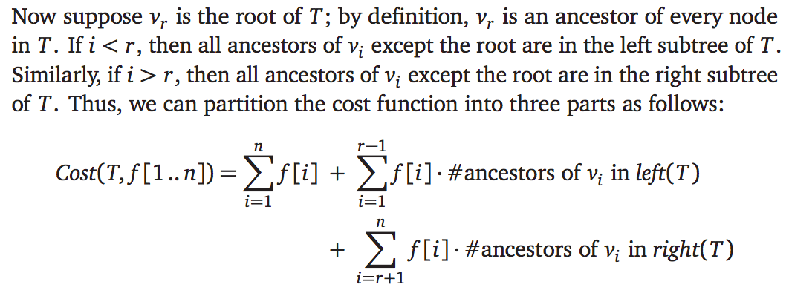
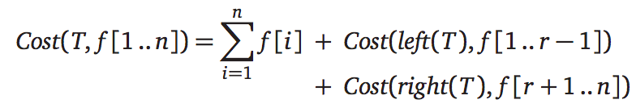
Optimal Binary Search Trees: Recurrence
Simple substitution now gives us a recurrence for Cost

Slide 26
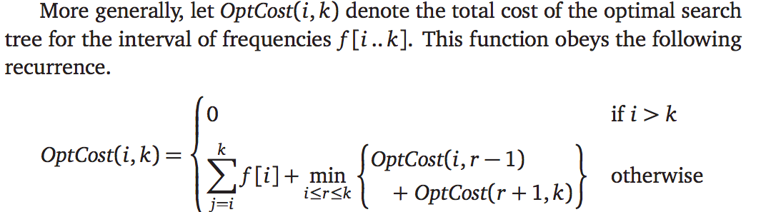
Optimal Binary Search Trees: Recurrence

Slide 27
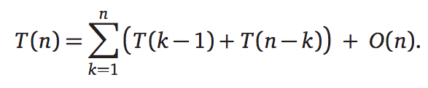
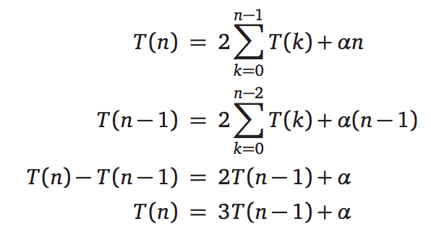
Analysis of the algorithm
This solves to T(n) = O(3^{n}) as can be shown by induction or using recursion tree.

Slide 28
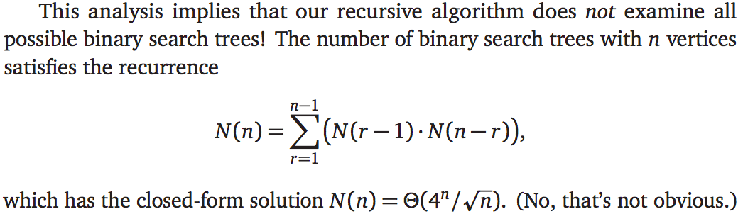
Remark: The backtracking algorithm is faster than brute-force
Our algorithm is faster because we optimize the left and right subtrees independently for each root.

Slide 29
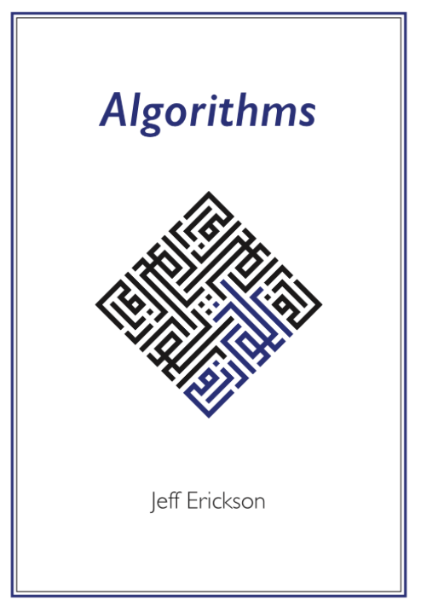


Credits
Slides are inspired and largely based on
Jeff Erickson’s book ‘Algorithms’.
They contain copy-paste portions of
the book.

